Slide 1

Writing simpler ASP.NET Core
It’s the future!!
Come join the Not So SOLID Crew!
Notes:
Thanks to the team at DDDScotland for putting this on. This is the second time I’ve been to Scotland, first time when I was about 7-8. We supposed to be here for 2 weeks but after constant torrential rain for a week my father decided he’d had enough of Scotland and we came home early. Glad to see its [stayed the same][ improved]
That’s a reference for those who are down with the kids like me using a pop group from 15 years ago!
Thrown some slides together, please ask questions along the way. I’d like it be more of a discussion rather than me dryly showing you slides.

Slide 2
Who am I?
I asked Twitter to write my profile!
@mrsacs
@danbarua
J Channon - he's alright but he smells a bit. Couch for sale.
Possesses all five fingers on each hand, leading one to suspect he's not really from round 'ere. "He's not so bad when you get to know him.
@joe_stead
@chrissie1
MVP, Architect, Twitter Complainer, GitHub enthusiast.
Said no-one ever
@ntcoding
@luisrudge
Johnny Chanson. A World Class village idiot with deep expertise in circumventing the best features of type safe programming languages. In addition he is literally a canon
Knows his shit
@morcs
@jchannon
Oursourcer of bios
Got into OSS, got child named after him, isn't that right @khellang ?!
Notes:
I am English, apologies but I’ve been sent by Amber Heard the Home Secretary to see if we have any people in Scotland who know about important things like encryption, algorithms and hashtags to strengthen our position in Brexit negotiations.
Who ready my profile before coming to this session?
And you still came?

Slide 3

Jonathan Channon
Another Random Developer
Software Developer, @NancyFX MVM, @omnisharp Sublime Plugin Author, Botwin author, Microsoft ASPNet MVP, Husband, Father & All Round Nice Guy!
 http://www.vqcomms.com
 https://github.com/jchannon  https://twitter.com/jchannon → jonathan.channon@gmail.com

Slide 4
SOLID Design Principle
As a rock!
S
O
L
I
D
Single Responsibility
Open/Close
Liskov Substitution
Interface Segregation
Dependency Injection
A class should have one, and only one, reason to change.
You should be able to extend a classes behavior, without modifying it.
Derived classes must be substitutable for their base classes.
Make fine grained interfaces that are client specific.
Depend on abstractions, not on concretions.
https://www.microsoft.com/net/learn/architecture
Notes:
SOLID has been used for the past 10 years or so and most developers learn this pattern and apply it at all new projects they start on, tell others to use it. It’s copy and pasted from each project.
It’s so engrained into developers development process that we don’t question it.
In fact Microsoft have written some new documentation for application architecture for microservices & docker, modernizing .net apps and new ASP.Net Core apps. Guess what the underlying theme is in their application design?!
That is until I did as part of a performance problem at work 18months ago when we had issues with our web apps on mono.

Slide 5
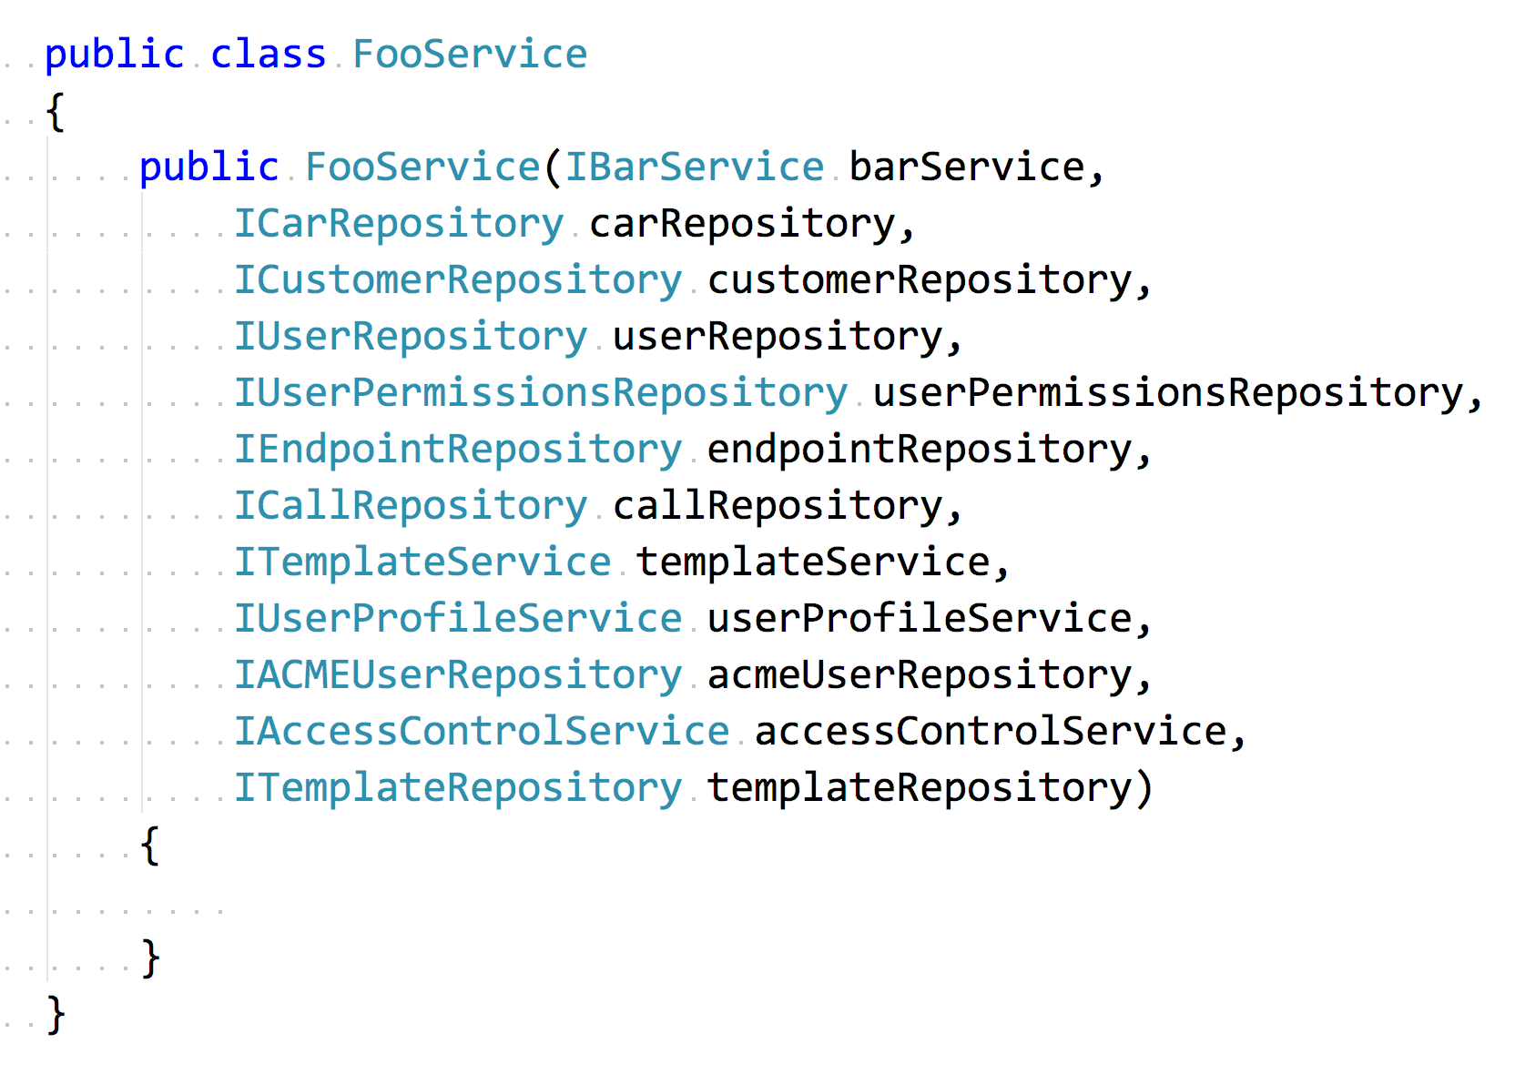
Exhibit A
You honour!
Notes:
Have any of you seen something like this before?
I ran some dotTrace profiling on our application and one area it picked up was reflection was being slow.
I thought to myself we don’t use reflection anywhere then realised it was complaining about constructors so it must have been my IOC container because under the hood that’s all its doing, finding ctor types and create an instance with those types passed to it.

Slide 6
What to do?
It’s not all what it cracked up to be!
Swap IOC containers
We swapped out to a few containers and tried others
Analyse dependencies
How was each dependency used, was it used in a couple of places for example
More S in SOLID
Create more specific classes rather than a God service class
Consolidate
Put behaviour in one central place rather than abstracting for the sake of it
KISS
Write simple, readable code!

Slide 7
Project Morphing Time!
Show me the code
SOLID
MediatR
My MediatR
Functional
◉
◉
◉

Demo 1
Demo 2
Demo 3
Demo 4
An example of a typical SOLID web application
A look at MediatR and how we can consolidate behaviour and use dependencies only when we need them.
How can we lose our dependency on MediatR? That’s right, roll our own!
Magic time! Here we will remove our IOC cont

Slide 8


Demo Time!
Let’s Do This!
Notes:
I heard people talking about the approach to no mocks and no ioc and had always thought in my head how would you even do that and one possible solution I had was very messy. That was until I read a blog post from Mike Hadlow, him of EasynetQ fame!

Slide 9
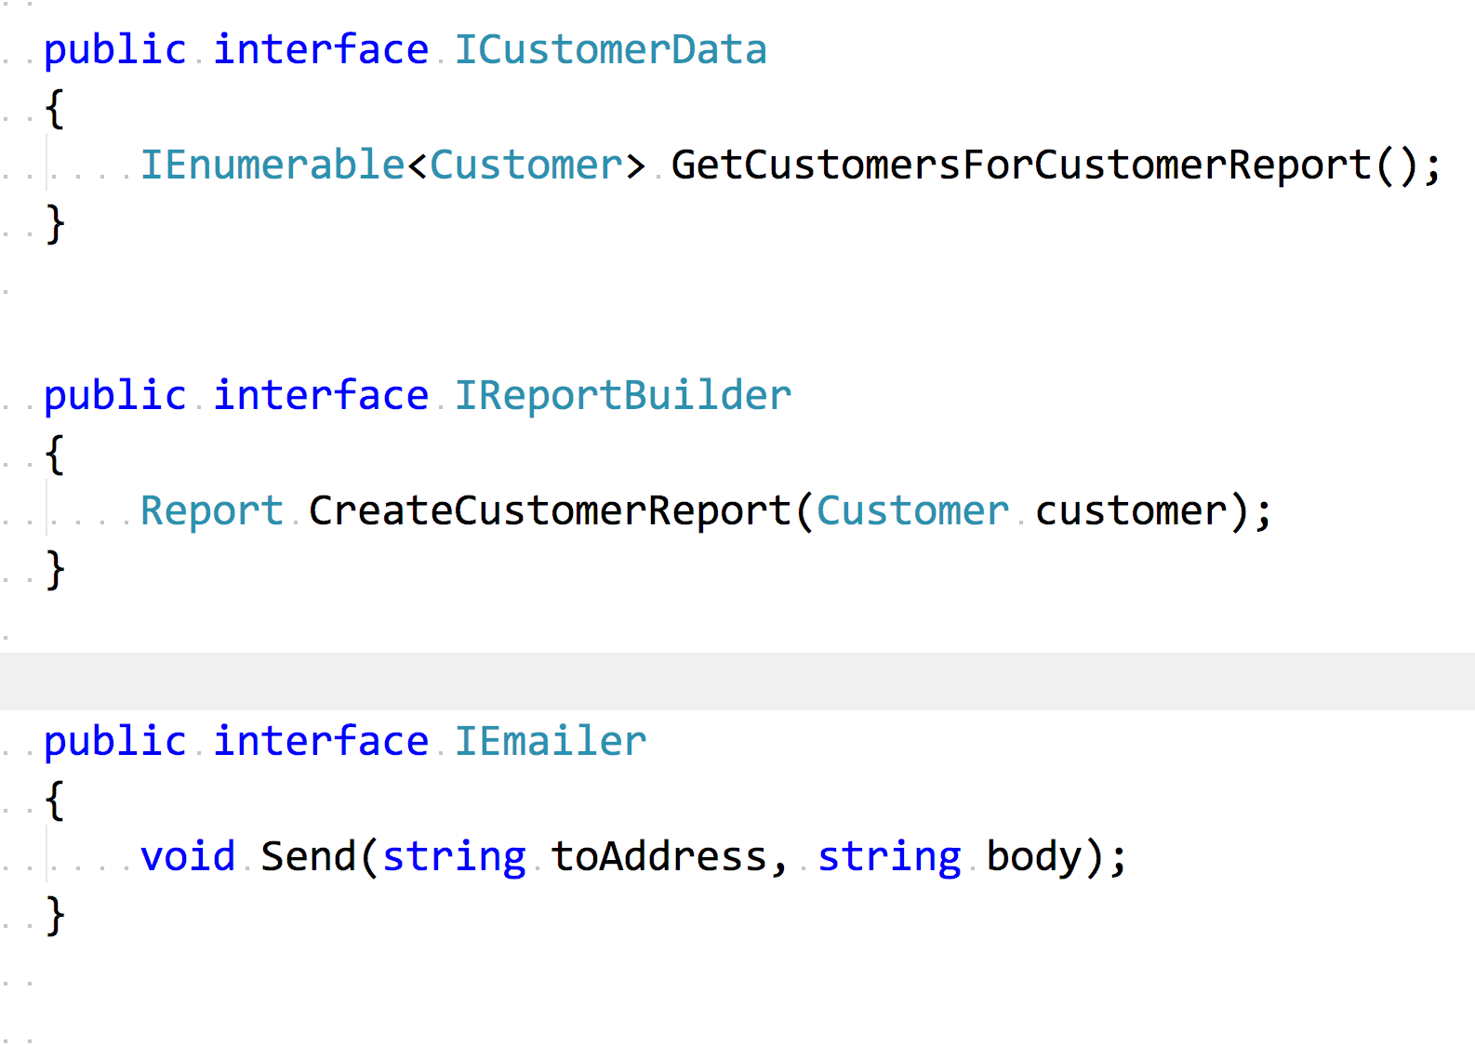

Slide 10
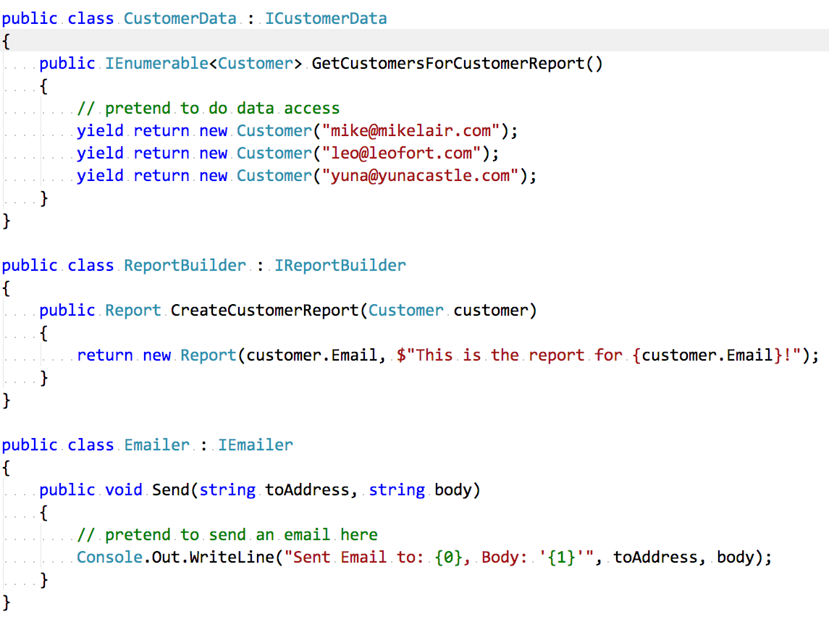

Slide 11
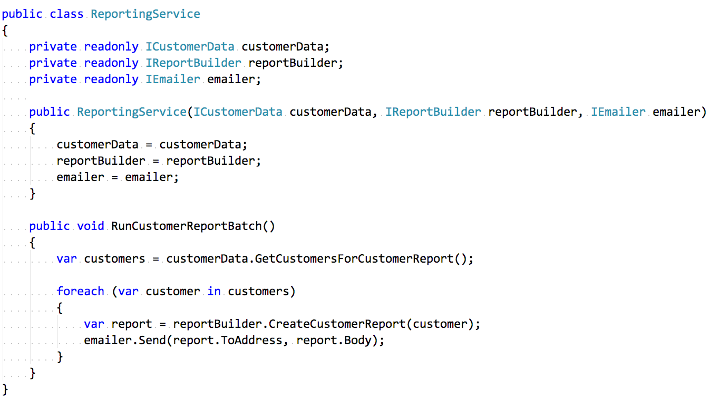

Slide 12
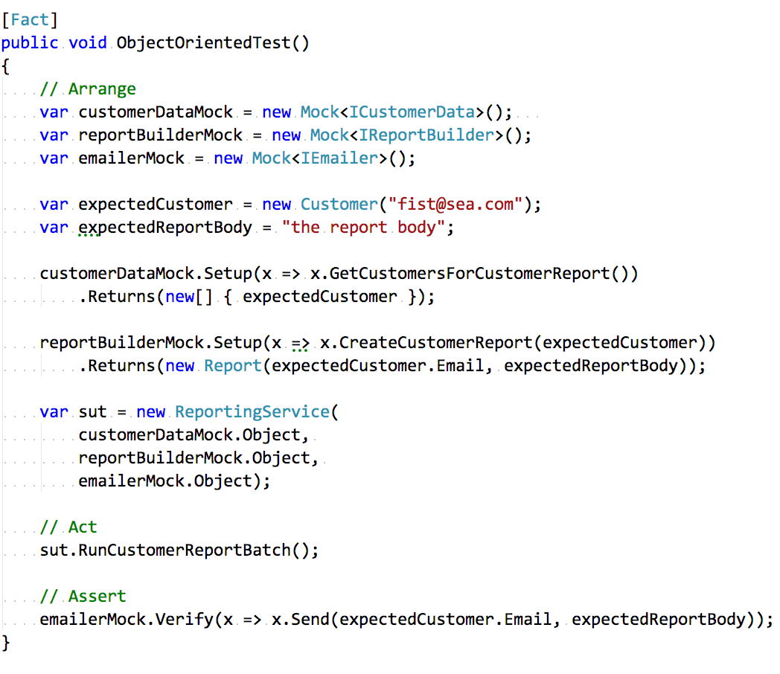

Slide 13
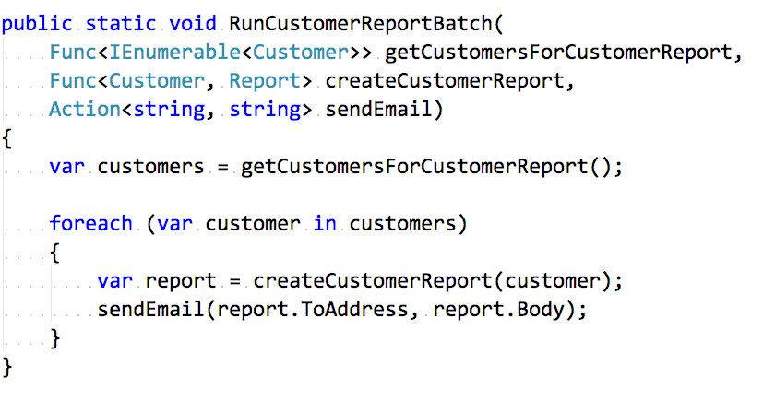

Slide 14
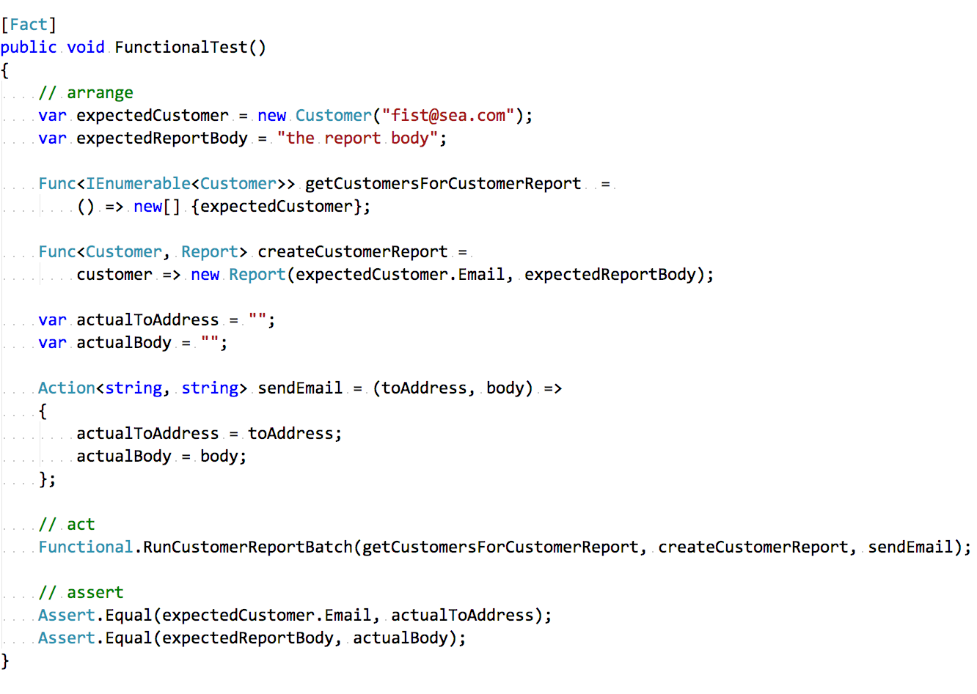

Slide 15
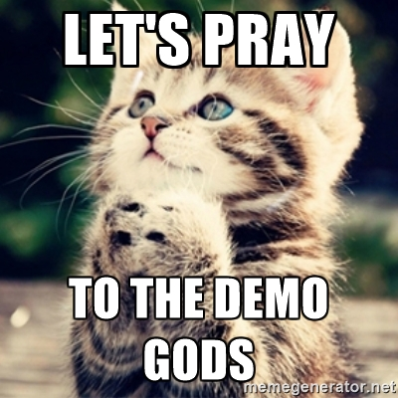

Demo Time…Again!
Let’s Do This!

Slide 16
Homework Time
Reading is fun
Mike Hadlow
Greg Young
01
Program Entirely in Statics - http://mikehadlow.blogspot.co.uk/2015/08/c-program-entirely-with-static-methods.html
02
The art of destroying software - https://vimeo.com/108441214
Mark Seemann
Brian Geihsler
03
SOLID the next step is functional - http://blog.ploeh.dk/2014/03/10/solid-the-next-step-is-functional/
04
Beyond SOLID: The Dependency Elimination Principle - http://qualityisspeed.blogspot.co.uk/2014/09/beyond-solid-dependency-elimination.html
Greg Young
Dan North
05
8 Lines of Code - https://www.infoq.com/presentations/8-lines-code-refactoring
06
Why Every Element of SOLID is Wrong - https://speakerdeck.com/tastapod/why-every-element-of-solid-is-wrong

Slide 17



Conclusion
You know it makes sense Rodney!
Should I still follow SOLID?
I’ve just seen something else!
It works!
Have a think to see if it still solves your problems or if there is another approach
Its productive but also enjoyable to use!
Less dependencies & more performance! Next problem please!

Slide 18

Thanks for your time!
Go forth and hack!
Source Code : github.com/jchannon/T1000
Notes:
10 points to why it’s called T1000?!

Slide 19

Homework
Lightweight, low-ceremony, framework for building HTTP based services
The "super-duper-happy-path” is a phrase we coined to describe the ethos of Nancy; and providing the “super-duper-happy-path” experience is something we strive for in all of our APIs.

Slide 20
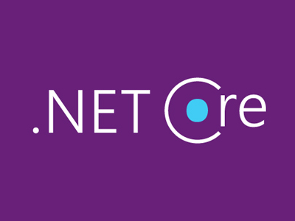

Welcome
What is .Net Core and Nancy HTTP Framework?
○
CODE SCREENSHOT HERE
What is this wizardry?
We’re going to look at what .Net Core is and what it means for the future of projects and the impact it can have and how there are alternatives to ASP.Net

Slide 21
SOLID Design Principle
How did we get to where we are today?
VQ & Linux
Mono
S
I joined and was tasked with making the product run on Linux as it was shipped as an appliance/black box and 90% of customers wanted Linux.
I
Only way to run .Net on Linux was to use Mono. This was an OSS project aimed at replicating .Net on Linux/OSX.
Omnisharp
Microsoft & Omnisharp
O
A Nancy web server that provided C# syntax analysis Editor agnostic – Vim, Sublime
D
We collaborated with MS to make Omnisharp server tip top.
Omnisharp Sublime was born after MS showed interest.
.Net Core
VSCode
L
“We’re going to make a cross platform runtime so the editors and it can work together!”
06
We’re going to write our own editor that uses Omnisharp and a plugin model.
Golang, Swift, Elixir successful plugins
Notes:
2. Initially great but seg faults, we had to send PRs to mono, use different Linux kernels. Once used to VS & Resharper, Xamarin Studio is a let down.
3. I met Jason Imison who wrote it for VIM
3. I saw MS doing something with Kestrel so I joined Jason, myself and a few others in other editors together
4. David Fowler re-wrote it in ASP.NET Core for dogfooding
6. 24,000 installs later I stopped work on Sublime.
6. Shameless plug - C# Extensions 24,000 installs in 1/3 time of Sublime

Slide 22
.Net Standard
What the what?
.Net Standard is a specification for a set of APIs that the below runtimes to implement.
Enables developers to produce portable libraries that are usable across .NET runtimes, using this same set of APIs.
Platform Name Alias
.NET Standard netstandard 1.0 1.1 1.2 1.3 1.4 1.5 1.6 2.0
.NET Core netcoreapp → → → → → → 1.0 vNext
.NET Framework net → 4.5 4.5.1 4.6 4.6.1 4.6.2 vNext 4.6.1
Mono/Xamarin Platforms → → → → → → → vNext
Universal Windows Platform uap → → → → 10.0 → → vNext
Windows win → 8.0 8.1
Windows Phone wpa → → 8.1
Windows Phone Silverlight wp 8.0

Slide 23






Nancy Core Contributors
The Team!
Andreas “@thecodejunkie” Håkansson
Steven “@grumpydev” Robbins


Jonathan “@jchannon” Channon
Kristian “@khellang” Hellang


Damian “@randompunter” Hickey
Christian “@chr_horsdal” Horsdal


Notes:
Might recognise Kristian Hellang, seems everywhere
Damian is DDD/ES man
Christian written 2 books for Nancy

Slide 24
Nancy
What is it?
Is it MVC?
View Engines
01
Nancy does not force you to use any pattern however it can do MVC if you wish
02
Comes with various view engines for example Razor
Super Simple
Markdown & more
Easy Testing
Automatic Dependency Injection
03
Nancy comes with its own testing library allowing you to test the whole request/response pipleine in memory
04
Built in IOC container called TinyIOC which will wire up all your dependencies automatically however, you can customise how things are wired plus you can use your container of choice if you prefer
Extensibility
Terse Syntax & Less Ceremony
05
Nancy is designed to be completely customisable and extensible. Drop in an interface implementation and off you go. Can replace serializers, view renderers, response processors even the whole Nancy engine
06
You can fit a nancy app in a tweet!
No setup to get going, just write a module and you’re ready to go!

Slide 25
Nancy
What is it?
Runs anywhere
Content Negotiation
07
Runs on .Net Framework, .Net Core, Mono
Can run inside an existing MVC app, can run inside WPF app!
08
Nancy comes with conneg out of the box with Json, JsonP & XML. It has negotiation extensions to change the model based on accept headers or use a view if text/html asked for.
Pipeline Hooks
No dependencies
09
Nancy provides hooks at the application level and module level such as OnBefore & OnAfter. It also provides an application OnError hook.
10
Nancy has no dependencies. It is one dll. Nancy builds requests and responses from the ground up and it is not tied to anything in .Net
Opt-in
Support & Community
11
Nancy provides packages like serializers, viewengines, hosting, validation and more so you can opt-in to additional functionality if you require it.
12
We have over 600 slack members
Over 250 contributors
We are innovative & quick – ASP.Net Core look familiar?!
Notes:
7. Thanks to VQ for the .Net Core sponsorship

